Slide 1
Credit Risk Specialist - Assignment

Slide 2
SECTION 01
Negative Balance Management

Slide 3
Negative Balance — Definition & Risk Landscape
What is a Negative Balance?
Why It Matters
Key Risk Drivers
Negative Balance (NB) occurs when a customer withdraws or spends more than their available account balance, effectively creating unsecured short-term credit exposure.
Key Risk Area Impacted by Negative Balance-
Credit Risk
Liquidity Risk
Regulatory Risk
Fraud Risk
Customer Behaviour Risk
Operational Risk
Provisioning & Financial Impact
Where Does This happen in Fintech/ Banking?
NB is common in:
wallets
merchant settlement accounts
UPI credit / BNPL
credit cards
 | UK (FCA) | EU(EBA) | India (RBI)

Slide 4
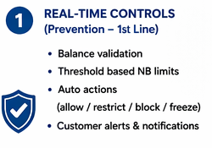
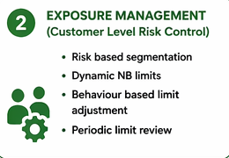
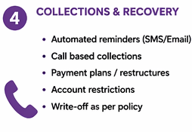
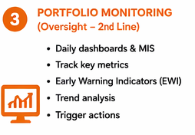
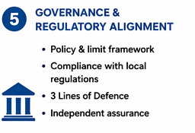
Negative Balance — Risk Management Framework
1st Line — Operations / Product
2nd Line — Credit Risk & Compliance
3rd Line — Internal Audit
Real-time balance checks before payment initiation
Automated block at transaction gateway when Limit Exceed – Create Exposure Limit.
Automated block at transaction gateway.
Customer Communication.
Daily exposure dashboard for Ops team
Independent NB exposure MI — daily ageing buckets (0-7d, 8-30d, 31-60d, 60d+)
Monthly limit reviews on aggregate NB exposure per market
Early warning Indicators.
Regulatory reporting: FCA Gabriel, RBI CRILC, EBA corep templates
Policy Design.
Model & Strategy Validation.
Quarterly audit of NB controls effectiveness
Sample testing of recovery actions vs policy
Validation of provisioning methodology
Regulatory change readiness reviews

Slide 5





Negative Balance Controls Framework — Three Lines of Defence
Key Metrics Monitored
Tools use to Report Negative Balance Exposure
Data Extraction & Storage
SQL Databases
Real-Time Monitoring & Alerting Tools
Transaction Monitoring systems
Event based alert systems
Fraud detection systems
MIS & Reporting Systems
Internal MIS reports
Schedule reporting systems

Slide 6
SECTION 02
Collections Oversight

Slide 7
Collections Framework
Segmentation
Automated Collections Workflow
Monitoring & KPIs
Low Risk Segment – Having Good Credit History – Soft Reminders.
Medium Risk Segment - Occasional delays – Calls+ nudges.
High Risk – Frequent NB / no repayment – Strong Action.
Day 0 (NB Created)
Instant SMS / App notification
Day 1-3
Reminder notifications & Email, App notification.
Day 3-7
SMS + call attempt; restrict outgoing payments (card present)
Day 8-30
Dedicated collections team; payment plan offered; hardship flag if SME distress signals
Day 31-60
Formal demand letter; account suspension; third-party agency referral assessment
Day 60+
IFRS 9 Stage 3; write-off with board approval; legal recovery where economically viable
KPIs
Recovery Rate
Roll Rate
Aging
Cure Rate
Dashboard Layout
Portfolio Overview
Aging & Delinquency analysis
Recovery performance
EWI

Slide 8
SECTION 03
Automated SME Credit Decisioning

Slide 9
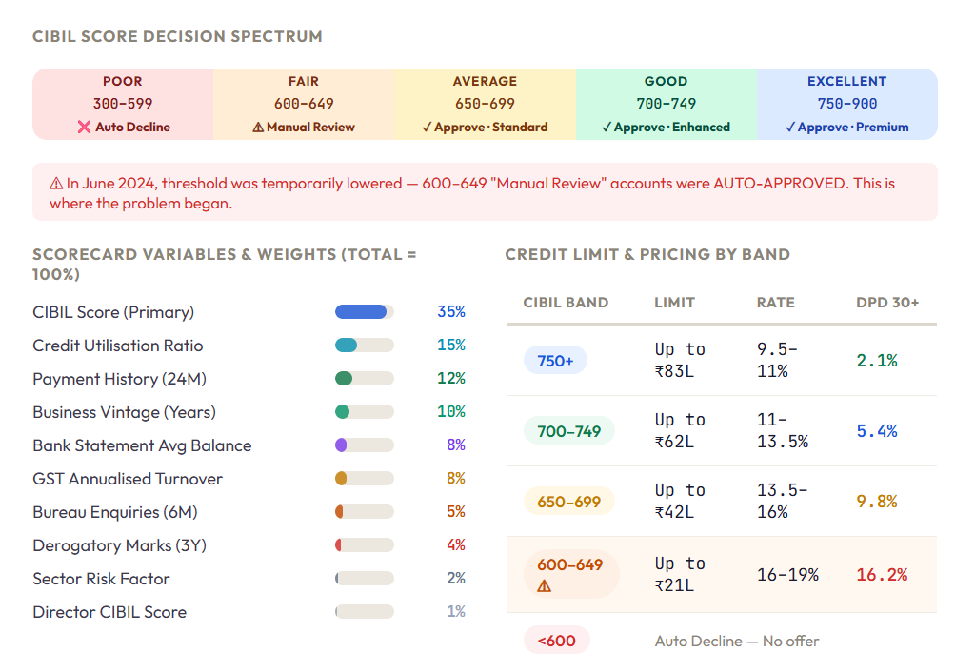
Portfolio At a Glance
The CIBIL-based automated scorecard used for NovaSME's revolving credit line — 10 variables used for Scorecard.
Situation (Q1 2024) – Nova SME Finance launches a revolving SME Credit product across India. Target retail shops, food stalls, professional service firms and construction business. Goal: deploy ₹15 Crore to 500 SMEs in 12 months using an automated CIBIL-based scorecard.
Decision (June 2024) – Business pressures mount. Origination volumes are lower that target. Management makes a call – lower the minimum CIBIL score threshold from 650 to 600 to approve more applications.
The Problem (By Dec 2024) - The Q2 2024 cohort begins to show alarming delinquency — 18.6% DPD 30+ by Month 9. That's nearly 2.4× the portfolio average. The credit risk team is called in. This presentation is the story of what they found — and how they fixed it.
Key Insight: Accounts with CIBIL 600–649 show 16.2% DPD 30+ — nearly 2× the next band. This band should never have been auto-approved. The scorecard's risk-return calibration was broken by the threshold change.

Slide 10
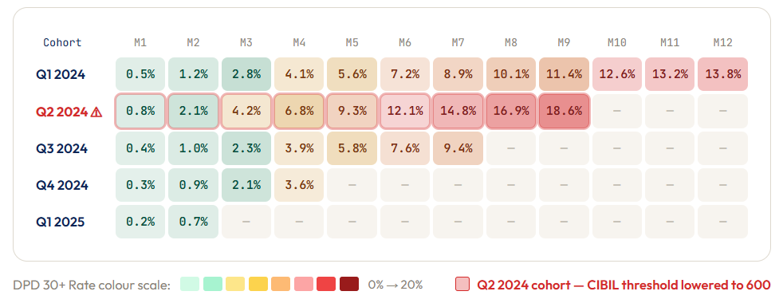
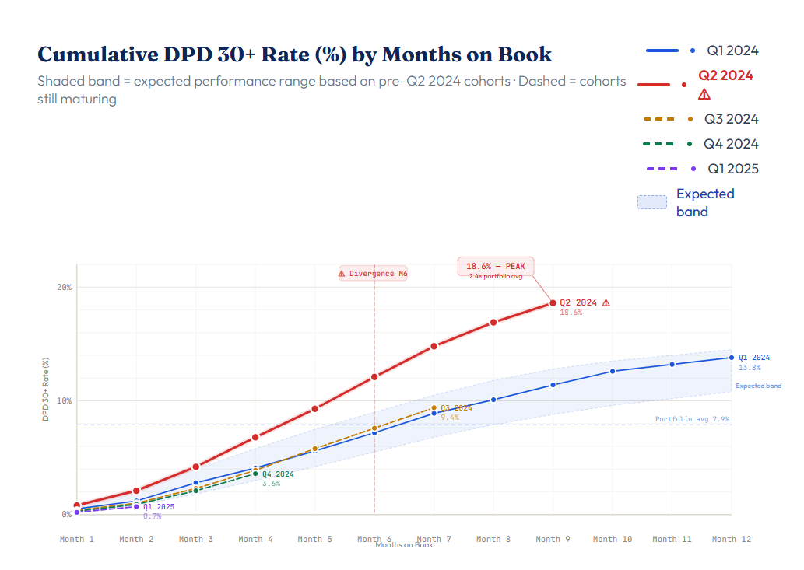
We plot every cohort against how they perform month-by-month. One cohort lit up red — Q2 2024.

Slide 11
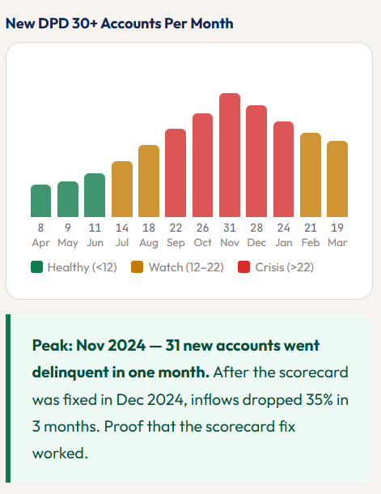
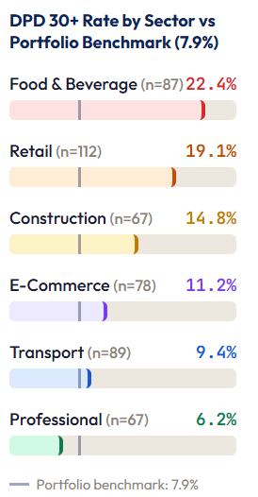
Sector analysis reveals Food & Beverage and Retail as the stress clusters. Professional services SMEs perform almost perfectly.

Slide 12
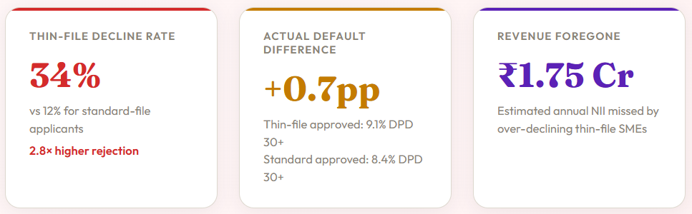
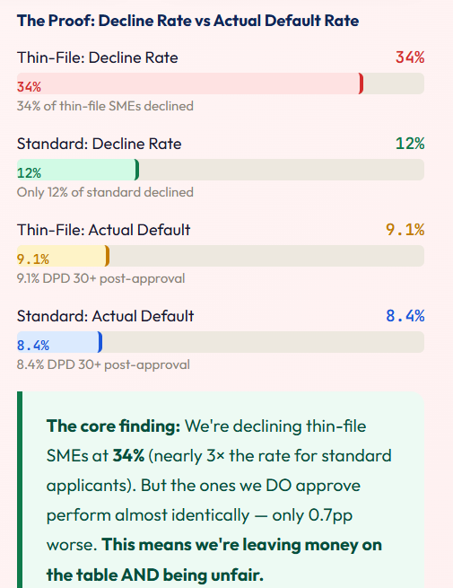
A Second Problem: We're Unfairly Rejecting Good Businesses
While investigating the Q2 2024 crisis, the team discovered something else. The scorecard was also hurting businesses that had never borrowed before — but were actually creditworthy.
How We Risk Manage the Thin-File Problem
Risk-Based Limits
Thin-file approvals get a lower starting limit (₹8.3L–₹20.8L) and 150–200bps higher pricing. A limit step-up mechanism rewards 12 months of good repayment behaviour.
Supplementary Scorecard
Build a parallel model for thin-file SMEs using GST compliance, bank statement cash flows, UPI volume, and trade references. Run alongside the main model in shadow mode first.
Enhanced Monitoring
Thin-file accounts monitored on a biweekly DPD cycle (vs monthly for standard). Early warning at DPD 10+. Collections outreach starts on Day 7 — not Day 30.

Slide 13
Overview With Senior Credit Committee
Key Findings
F1 The scorecard assigns 35% weight to CIBIL score. For thin-file SMEs, this score is absent or artificially low — causing the model to wrongly classify creditworthy borrowers as high-risk.
F2A back-test of 120 declined thin-file applicants using alternative data (GST, bank statements, trade references) shows 78 would have been creditworthy approvals — a 65% false-decline rate.
F3 Commercial impact: the thin-file segment is ~22% of SME applicant flow. Systematic declination costs NovaSME an estimated ₹1.5–₹2 Crore in annual foregone NII.
Recommendations — Action Required
R1 Launch a parallel thin-file supplementary scorecard using GST compliance, 6-month average bank balance, and UPI transaction volume. Run in shadow mode for 90 days.
R2 Establish a weekly Thin-File Manual Review Panel — 2 senior analysts, structured decision template, every declined thin-file case reviewed with documented rationale.
R3 Rebuild the main scorecard — reduce CIBIL weight from 35% to 25%, introduce a bureau thin-file flag, and add GST turnover and bank statement as explicit features.

Slide 14
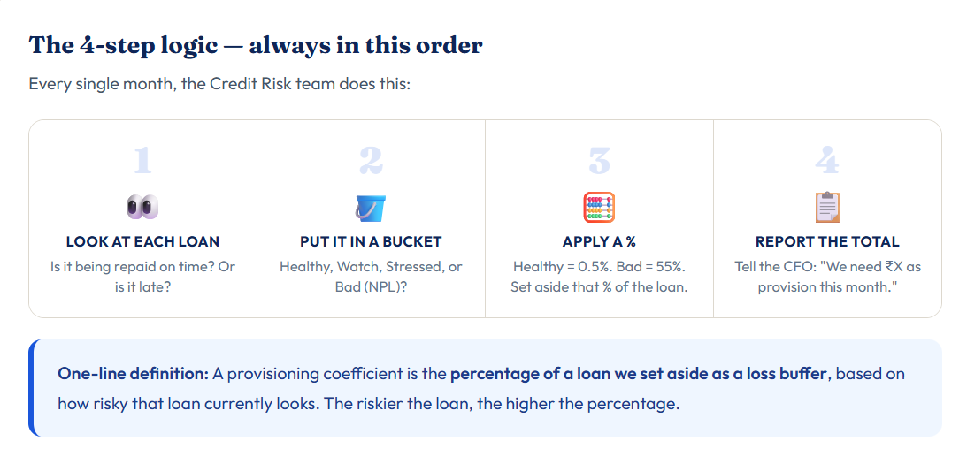
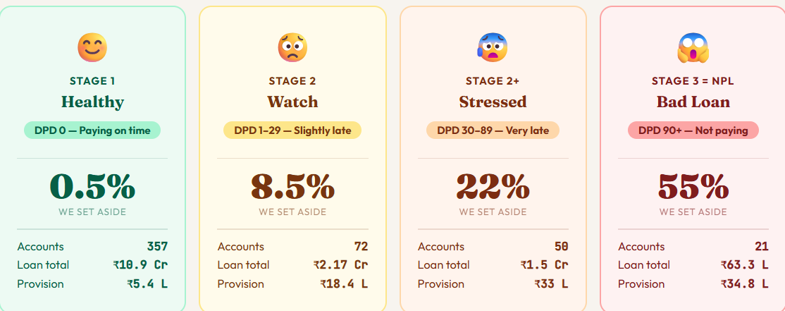
Provisioning Coefficients for the loan Portfolio
5 signals that make us review and change the coefficient-
Cure rate falls
DPD 30+ rate crosses
Too many accounts moving to worse stages.
Actual losses exceed what the model predicted

Slide 15
SECTION 03
Wholesale Credit Risk

Slide 16
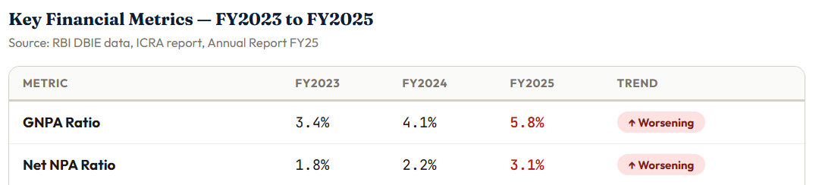
Wholesale Credit Risk
Case Study (Assumption) : Tide India holds member current account funds and operational capital across three Tier-2 banks. This is normal — diversification reduces concentration risk. Until one morning in March 2025.
Bank A – Karur Vysya Bank, Tide deposit 140 Cr. (AA)
Bank B – City Union Bank, Tide deposit 180 Cr. – (Downgraded AA to A+)
Bank C – South India Bank, Tide deposit 100 Cr. (A+)
ICRA has downgraded City Union Bank from AA to A+ with a "Negative Outlook." The reason cited: rising GNPA (Gross Non-Performing Assets) ratio, pressure on net interest margins, and concerns about the bank's commercial real estate loan book. Tide has ₹180 Crore deposited here — 43% of its total India banking exposure.

Slide 17
Key Risk Findings
F1 Bank's GNPA ratio has deteriorated from 3.4% (FY23) to 5.8% (FY25) — above RBI's comfort threshold. Commercial real estate loans (22% of book) are the primary driver of stress.
F2 Negative Outlook signals ICRA may cut the rating again in 12–18 months. If the bank reaches A rating, our policy would require a full exit — potentially under less favourable liquidity conditions than today.
What Tide Should Do — Recommendation
R1 Immediately reduce exposure from ₹180 Crore to ₹100 Crore over 90 days by not renewing maturing fixed deposits and where necessary accepting premature closure costs (estimated ₹40–60 Lakh).
R2 Redeploy the ₹80 Crore to Karur Vysya Bank (ICRA AA, stable outlook) — already a counterparty we know. This restores our concentration to 24% and eliminates the policy breach.
R3 Place City Union Bank on Enhanced Watch — monthly financial review instead of quarterly. Trigger a full Exit decision if: (a) GNPA crosses 7%, (b) ICRA downgrades to A, or (c) RBI issues corrective action.
R4 Review all three bank counterparty limits at the next Board Risk Committee — tighten concentration limit from 35% to 30% per bank, and require a minimum ICRA A+ (Stable) for any new deposits.

Slide 18
Wholesale Credit Risk - Option
Option A - Reduce ✓ Recommended
Reduce from ₹180 Cr to ₹100 Cr over 90 days.
Pros • Phased — minimises premature FD penalty • Bank remains viable — no panic withdrawal • Redeploy ₹80 Cr to higher-rated bank
Cons
• Some FD premature closure cost (~₹40–60L) • Retains ₹100 Cr at A+ rated bank
✓ Our Recommendation
Option B — Exit
Withdraw all ₹180 Crore immediately.
Pros
• Zero concentration at this bank • Maximum risk elimination
Cons
• Large premature FD penalties (~₹2–3 Crore) • Bank is still rated A+ — exit feels premature
Reduce Tide's exposure from ₹180 Crore to ₹100 Crore over 90 days. Redeploy the ₹80 Crore to Karur Vysya Bank (AA rated)

Slide 19
Thank You

